Slide 1
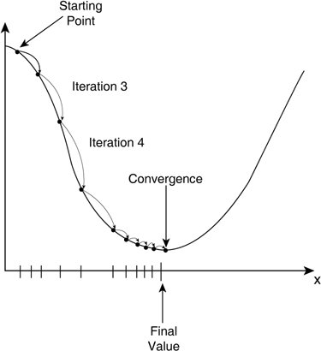
Gradient Decent

Slide 2

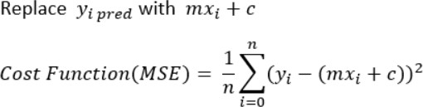
MSE Function

Slide 3
Step : 01
Initially,
Gradient (m) = 0 Intercept (c) = 0
Learning Rate (L) = ~0.0001
Derivatives: https://www.dummies.com/article/academics-the-arts/math/calculus/the-most-important-derivatives-and-antiderivatives-to-know-188540/

Slide 4
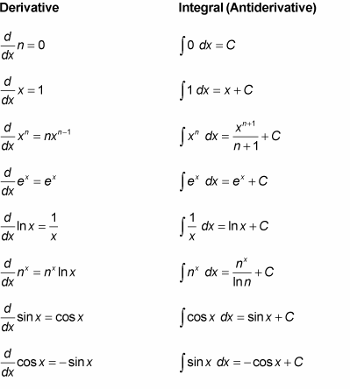
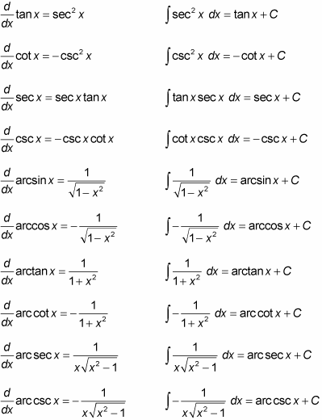
Derivatives: https://www.dummies.com/article/academics-the-arts/math/calculus/the-most-important-derivatives-and-antiderivatives-to-know-188540/

Slide 5
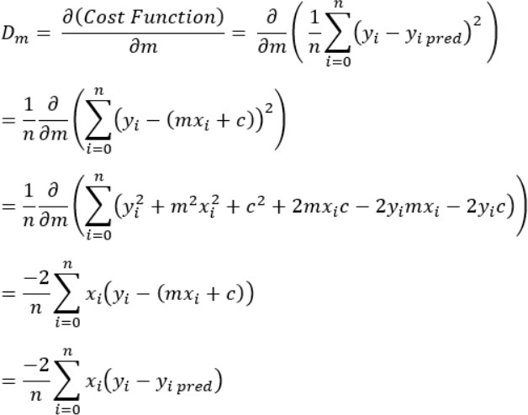
Step : 02
Calculate the partial derivative of the Cost function with respect to m. Let partial derivative of the Cost function
with respect to m be Dm.

Slide 6
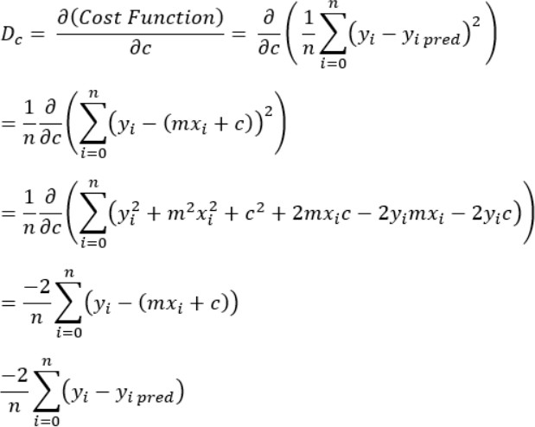
Step : 03
Similarly, let’s find the partial derivative with respect to c. Let partial derivative of the Cost function with respect to
c be Dc.

Slide 7
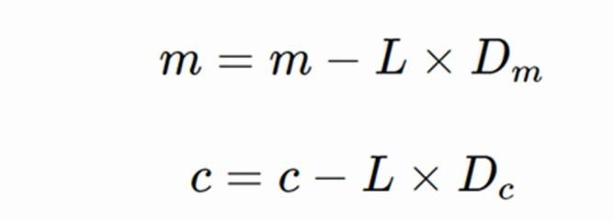
Step : 04
Update the Value of m & c

Slide 8
Step : 05
Repeat Step 03 & Step 04

